Slide 1

CalARP Hazard Reviews Process Hazard Analysis November 6, 2025

Slide 2
Session Agenda
Introduction and Overview
Regulatory Requirements
Methodologies
PHA Team
Items to Address in PHA

Slide 3
Objectives
Understand the PHA process
Improve PHA documentation
Acquire tools for use in PHAs
Evaluate the effectiveness of a PHA
Identify potential gaps in safety

Slide 4

Poll Question 1
What has been your role in a hazard review or PHA?

Slide 5

Poll Question 1
What was your role in a hazard review or PHA?

Slide 6
Process Hazard Analysis
Purpose
Identify and analyze significant hazardous situations of a process.
Aid in decision making for improving safety and managing risk.
Desired outcomes
Fewer incidents
Reduced consequences
Evaluate compliance

Slide 7
Process Hazard Analysis
Limitations
Impossible to identify and assess the significance of all possible causes and outcomes
Studies are a snapshot in time
Results may be subjective based on team knowledge and experience
No certainty that all hazardous conditions and potential incident scenarios are identified

Slide 8

Process Hazard Analysis
Scenario Anatomy
Mitigated Impacts
Hazards
Regain control or shut down
Cause
Mitigative Safeguards
Preventive Safeguards
Deviation
Containment and Control
Loss Event
Unmitigated
Impacts

Slide 9

PHA Process
Gather information on the process
Review and evaluate potential gaps
Perform study with qualified team
Address recommendations
Update and revalidate

Slide 10
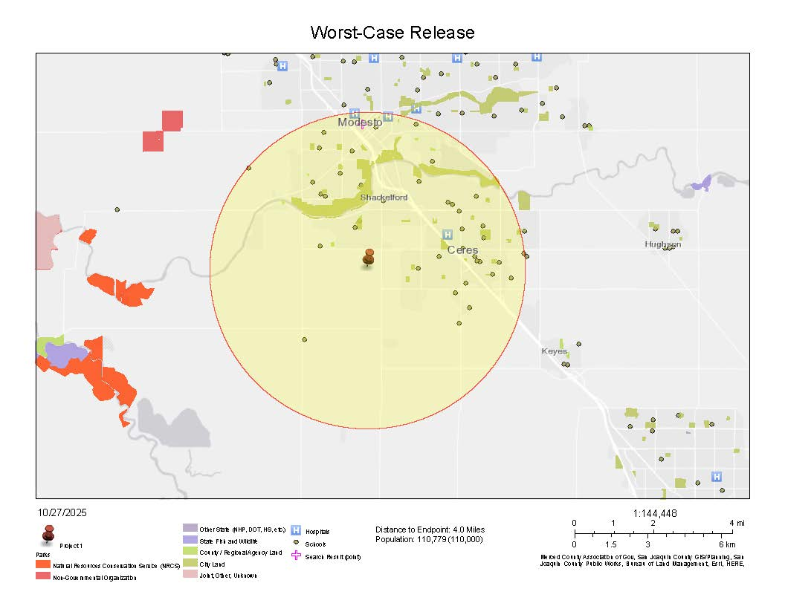
PHA Process
Gather information on the process
Reference information (BFD, P&IDs, operating limits, procedures, EAP/ERP, facility siting information, etc.)
Previous incidents
Walkdown of the process
Equipment condition
Access and egress
Guarding

Slide 11

PHA Process
Review and evaluate potential gaps
Complete and accurate
Formulate questions for team
Conformance to industry standards

Slide 12

PHA Process
Perform study with qualified team
Walkdown of the process
Orientation on PHA Methodology
Identify potential causes (initiating events)
Document containment control, safeguards and mitigation measures for scenarios
Evaluate safety and health effects of failures
Suggest additional safeguards or recommendations where appropriate.

Slide 13

PHA Process
Address Recommendations
Recommendations may not always be explicit
Implement as described
Decline to adopt

Slide 14
PHA Process
Justifiably decline to adopt a recommendation
Document, in writing and based upon adequate evidence, that one or more of the following conditions are true:
Analysis contains material factual errors;
Recommendation is not necessary to protect health & safety of employees of owner and/or contractors;
An alternative measure would provide sufficient level of protection; or
Recommendation is infeasible
Determination of infeasibility shall not be based solely on cost.

Slide 15

PHA Requirements
Perform an initial PHA prior to submittal of the RMP
With appropriate complexity of the process
Identify, evaluate, and control the hazards involved in the process
Update and Revalidate based on the PHA completion date at least every 5 years
Notes:
REVALIDATION DEF … verify that past studies remain valid and that changes made to the covered process are properly assessed

Slide 16
PHA Requirements
Revalidation
Hazards are documented,
Safeguards are accurate,
Past recommendations have been addressed,
Risk ranking of each scenario is accurate, and
Relevant incidents and near misses at the stationary source and industry are evaluated.
OSHA Standard Interpretation, 1910.119(e)(6) - Steps for updating and revalidating a Process Hazard Analysis (PHA). - 01/22/1998
Notes:
Limited revalidation to once for P2 Hazard Reviews

Slide 17

PHA Requirements
Revalidation Guidelines:
Adequate documentation from previous study
No major process or knowledge changes
Hazards of the processes are tolerable
No significant incidents have occurred
Previous PHA meets requirements and recommendations have been addressed.

Slide 18
PHA Methodology: Checklist
Easy and quick to perform
Respond to questions
No cause and consequence
Not always process specific
Very limited in identifying:
Detection method
Safeguards
Consequences
Safety and health effects of failure of controls

Slide 19

PHA Methodology: What-If/Checklist
Less structured than other methods
Works well for brainstorming
What-if/checklists may be available for certain industries.
If used, questions should be site-specific and appropriately complex

Slide 20
PHA Methodology: What-If/Checklist
Easy to understand
Less time and effort
Results are dependent on experience and thoroughness
Covers hazards and consequence of failure
Safeguards and control methods

Slide 21

PHA Methodology: HazOp
HazOp studies are intended to identify system design and operational features that could lead to a chemical release.
Systematic review of the design, operation, and maintenance of a process using a Guide-word Deviation Matrix.

Slide 22
PHA Methodology: HazOp
Guideword Deviation Matrix | Guideword Deviation Matrix
Design Parameters | More | Less | None | Reverse | Part of | As well as | Other than
Flow | High flow | Low flow | No flow | Back flow | Wrong concentration | Contaminants | Wrong materials
Pressure | High pressure | Low pressure | Vacuum
Temperature | High temperature | Low temperature
Mixing | Excessive mixing | Poor mixing | No mixing |  |  | Foaming
Level | High level | Low level | No level
Reaction | High reaction rate | Low reaction rate | No reaction | Reverse reaction | Incomplete reaction | Side reactions | Wrong reactions
Time | Too long | Too short |  |  |  |  | Wrong time
Sequence | Step too late | Step too early | Step left out | Steps performed backwards | Part of step left out | Extra action included | Wrong action taken

Slide 23
PHA Methodology: HazOp
Systematic approach to hazard scenarios
Node focus can miss scenarios on interactions
Significant time and effort
Covers hazards and consequence of failure
Safeguards

Slide 24

Poll Question 4
What is your preferred PHA methodology?

Slide 25
PHA Methodology
Coordinate with the AA (CUPA) on methodology and use one of the following:
What-If
Checklist
What-If / Checklist
Hazard and Operability Study (HAZOP)
Failure Mode and Effects Analysis (FMEA)
Fault Tree Analysis
An appropriate equivalent methodology

Slide 26
PHA Requirements
Address findings and recommendations
Document resolution of recommendations
Action to be taken
Develop a written schedule (estimated completion)
Final resolution taken
Actual completion date

Slide 27
PHA Requirements
No. | L | C | R | Node | Safeguards and Control Measures | Suggested Safeguards and Control Measures | Estimated Completion Date | Management Response/Action Taken | Assigned To | Date Completed
1.03 | 2 | 3 | B | Node 1 System Overview | Autodial message to operator on chlorine alarm. Alarm strobe and siren at well. Quarterly bump testing of chlorine sensors. Operators observe condition of sites every 3-days. Continuous SCADA monitoring of alarms. Ventilation system runs continuously. | Update the Chlorine Leak Alarm Response Procedure to include the phone numbers for Emergency Response Agencies including the CUPA, California Office of Emergency Services and the National Response Center. Include in the procedure, the level that would require a notification of outside agencies. Document the coordination of emergency response actions with local fire department and hazmat response team. |  |  | Chief Plant Operator, John Doe
2/20/2026
Updated Chlorine Leak Alarm Response Procedure and EAP to include emergency contact phone numbers and notification requirements for chlorine releases.
Sent EAP to local fire department and county hazmat response team and invited agencies to attend emergency evacuation drill.
6/20/2025
9/10/2026

Slide 28

PHA Requirements
Timetable for Completing Recommendations
Agreeable by the CUPA;
Within 2.5 years; or
The next planned turnaround, if required.

Slide 29


PHA Requirements
Communicate actions to employees affected by recommendations
Retain PHAs and documentation on resolution of recommendations for the life of the process

Slide 30
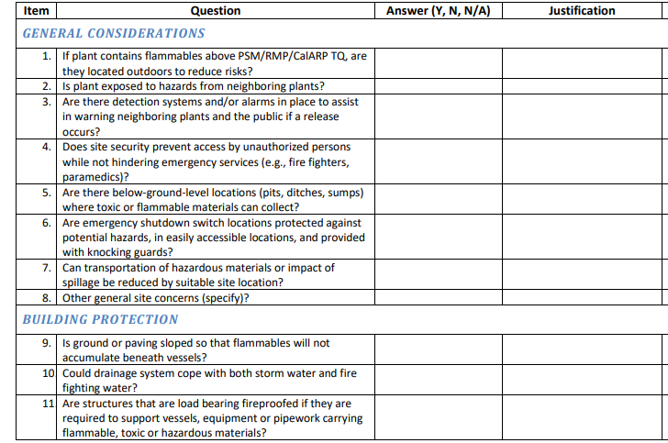
Facility Siting
Evaluate whether process location creates risks for onsite personnel or offsite public or environmental receptors.
Contra Costa Health Services Facility Siting Checklist

Slide 31

Human Factors
Process safety relies on people
Execution of tasks
Response to incidents
Procedures
Equipment
Controls
Scheduling
Contra Costa Health Services Human Factors Checklist

Slide 32
Previous Incidents
Reference to incident investigation reports
Include near misses
Verification that incident investigation findings have been addressed
Consider incidents at other facilities where duplication could occur

Slide 33
Previous Incidents
Key Lessons for Preventing Hydraulic Shock
Key Lessons for Preventing Hydraulic Shock in Industrial Refrigeration Systems

Slide 34

PHA Team
Experienced and knowledgeable team is essential
Appropriate number of team members
Requirements:
Expertise in engineering and operations
Specific knowledge and experience of the process
Knowledge of the methodology

Slide 35

PHA Team
Roles:
Facilitator – Provides direction and organization
Scribe – Responsible for documenting the study
Contributors – Provide knowledge and expertise with practical experience in operations, maintenance and engineering.

Slide 36

Items to Address
Hazard: A physical or chemical condition that has the potential for causing harm to people, property, or the environment.
Hazards of the process:
Hazardous consequences
Process and facility conditions that could produce undesirable consequences

Slide 37

Items to Address
Engineering and administrative controls applicable to the hazards
Detection methods providing early warning of releases
Consequences of failure of engineering and administrative controls
Evaluation of safety and health effects

Slide 38
Items to Address
Safeguards and control measures
Compressor high discharge pressure cutout at 210 psig.
Emergency pressure control system activates at 225 psig.
PRVs set pressure of 250 psig and relief to diffusion tank.

Slide 39
Items to Address
Risk Ranking
Likelihood (L) Expected frequency of cause to happen?
With safeguards in place
Consequence (C) What is the expected outcome?
Assuming safeguards fail
Risk (R) is based on likelihood and consequence levels

Slide 40
Items to Address
Risk Ranking Matrix

Slide 41
Items to Address
Risk Level Explanation
A: Unacceptable, #1 priority to reduce risk within 12 months
B: Undesirable, #2 priority to reduce risk within 30 months
C: Tolerable with ongoing administrative and engineering controls
D: Acceptable as is

Slide 42
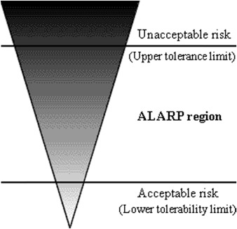
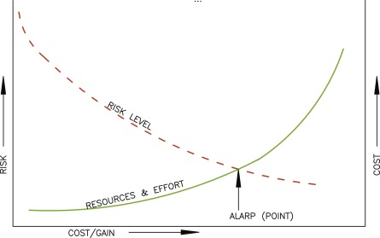
Risk Ranking
Notes:
As low as reasonably practicable (ALARP).

Slide 43




External Events
Seismic
Weather
Traffic
Onsite Incidents
Offsite Incidents

Slide 44
External Events
Seismic Assessments
Revalidated at least every 5 years
Must be conducted for RMP to be deemed as complete during the regulatory RMP review process.
CalARP Seismic Assessment Guidance
Notes:
New facilities designed and built to 2022 Building Code satisfy analytical evaluation, but walkdown should still be conducted.

Slide 45
Review: Process Hazard Analysis
Purpose
Identify and analyze significant hazardous situations of a process.
Aid in decision making for improving safety and managing risk.
Desired outcomes
Fewer incidents
Reduced consequences
Evaluate compliance

Slide 46
Review: PHA Process
Gather information on the process
Review and evaluate potential gaps
Perform study with qualified team
Address recommendations
Update and revalidate

Slide 47
References
Center for Chemical Process Safety. 2019. American Institute of Chemical Engineers. CCPS Monograph: Assessment of and planning for natural hazards
U.S. Chemical Safety and Hazard Investigation Board. 2018. Organic Peroxide Decomposition, Release, and Fire at Arkema Crosby Following Hurricane Harvey Flooding
Federal OSHA Interpretation Letters:
1910.119(e)(3) - Documentation methods used to comply with the qualitative evaluation of a range of possible safety/health effects of "failure of controls" requirement of the PSM standard. - 02/01/2005
1910.119(e)(3) - PSM compliance for ammonia refrigeration systems. - 07/12/2006
1910.119(e)(3) - Steps for updating and revalidating a Process Hazard Analysis (PHA). - 01/22/1998
1910.119(e)(5) - Documentation of PHA Findings and Recommendations - 10/02/2020
1910.119(e)(6) - Updates to PHA Extended Shutdown Facility - 09/20/2019
1910.119(e)(7) - Documentation of PHA Findings and Recommendations - 10/02/2020

Slide 48
References
Other resources:
Guidelines for Hazard Evaluation Procedures, 3rd Edition
Contra Costa Health Services CalARP Program Guidance Documents
EPA FAQ: What constitutes a revision of the PHA?
Key Lessons for Preventing Hydraulic Shock in Industrial Refrigeration Systems
CalARP Seismic Assessment Guidance
CSB: Extreme Weather Safety Message Video
DSOD Dam Breach Inundation Map
ATC Wind, Snow, Tornado and Seismic Hazard

Slide 49

Any Questions?
Jack Becker ,
Compliance Services Manager jbecker@condorearth.com
209.454.7394

